Slide 1




THE SECOND INTERNATIONAL CONFERENCE ON
RESEARCH AND DEVELOPMENT IN INFORMATION, COMMUNICATION AND COMPUTING TECHNOLOGIES
(ICRDICCT-2026)
Conference Proceedings April 9th & 10th, 2026

Slide 2

Paper Presentation Details
Paper Title: AI-Driven Real-Time Crowd Management System for Public Safety
Paper ID: ICRDICCT – 122
Author(s):
                D. Yaswanth Guptha
                D. Sukesh Babu
                G. Lokesh
                G. Venkata Reddy
                Dr. Chennapradaga Amarendra

Slide 3
Table of Contents
1. Abstract
2. Introduction
3. Related Work
4. Proposed System / Methodology
5. Experimental Setup / Results
6. Analysis
7. Conclusion
8. References

Slide 4
1. Abstract
The design, implementation, and evaluation of an AI-driven real-time crowd management sys tem for public safety. The system combines computer vision (YOLOv8) for automatic people detection and counting across multiple monitored zones, a FastAPI-based backend with Web Socket support for live updates, and a multi-channel notification subsystem (SMS and email) for alerting when capacity thresholds are exceeded. The architecture integrates video streaming, asyn chronous monitoring, SQLite persistence, and a responsive web dashboard to support security teams and event organisers. We document system architecture (with linked diagrams), method ology, experimental results including sample detection output, and conclusions. The system fulfils functional requirements for multi-zone monitoring, density classification (green/yellow/red), real-time dashboard updates, configurable alerts, and emergency override, providing a deployable reference for crowd analytics and public safety monitoring. Keywords: crowd management, computer vision, YOLOv8, real time monitoring, public safety, object detection, alert system, FastAPI, WebSocket, multi-zone monitoring, density classifica tion, Twilio, SMTP.

Slide 5
2. Introduction
Background of the Domain
Rapid urbanization, large public gatherings, and high-footfall events have increased the need for intelligent crowd monitoring systems. Traditional manual surveillance is inefficient, error-prone, and unable to respond in real time.
Real-World Problem
Overcrowding in public places such as malls, event halls, transport hubs, and parking areas can lead to safety hazards, stampedes, delayed emergency response, and poor crowd control due to the lack of real-time visibility and automated alerts.
Importance in the Current Scenario
With growing concerns around public safety, disaster management, and smart city initiatives, there is a critical demand for AI-driven systems that can continuously monitor crowd density, detect abnormal situations, and assist authorities in taking timely preventive actions.
Proposed Solution (Overview)
This project presents an AI-Driven Real-Time Crowd Management System that uses computer vision and deep learning to detect and count people across multiple zones, analyze crowd density in real time, and generate automated alerts through SMS and email when safety thresholds are exceeded.
Objectives of the Project
To detect and count people in real time using deep learning–based object detection
To monitor crowd density across multiple zones and classify risk levels
To generate automated alerts for crowd congestion and emergency situations
To provide a real-time dashboard and API for monitoring, analysis, and decision support

Slide 6
3. Related Work
Crowd monitoring and management has been an active research area in computer vision and intelligent surveillance systems. Early approaches relied on manual observation and basic sensor-based counting, which were inefficient for large-scale and dynamic environments. With advances in computer vision and deep learning, automated crowd analysis using video streams has become more accurate and scalable.

Slide 7
3. Related Work
Key Existing Works (Selected Studies)
Viola and Jones (2001)
Introduced Haar cascade–based object detection for human detection. While computationally efficient, the method struggles in dense crowds and varying lighting conditions.
Dalal and Triggs (2005)
Proposed Histogram of Oriented Gradients (HOG) for pedestrian detection. This approach improved detection accuracy but was not suitable for real-time multi-camera environments.
Zhang et al. (2015)
Used regression-based CNN models for crowd counting in highly dense scenes. Although effective, these models require large annotated datasets and are computationally expensive.
Li et al. (2018)
Applied deep convolutional neural networks for crowd density estimation using surveillance footage. The approach improved accuracy but lacked real-time alerting and deployment focus.
Redmon et al. (2016)
Introduced YOLO (You Only Look Once), enabling real-time object detection with a single neural network. This marked a major shift toward real-time crowd analysis systems.

Slide 8
3. Related Work
Recent and Advanced Approaches
Bochkovskiy et al. (2020)
YOLOv4 improved detection speed and accuracy, making it suitable for live surveillance systems but requiring high computational resources.
Jocher et al. (2023)
YOLOv8 introduced lightweight models (YOLO nano) optimized for real-time detection on edge and low-resource systems, ideal for multi-zone crowd monitoring.
Patel et al. (2024)
Developed an AI-based crowd density monitoring system with threshold-based alerts, but the system lacked anomaly detection and scalable API integration.
Kumar and Singh (2025)
Proposed an IoT-integrated smart surveillance framework, focusing on data aggregation but with limited real-time visual analytics.

Slide 9
3. Related Work
Paper / Year | Technique Used | Dataset / Input | Key Result | Limitations
Dalal & Triggs (2005) | HOG + SVM | Pedestrian images | Improved detection | Not real-time
Zhang et al. (2015) | CNN Regression | Dense crowd images | High accuracy | High computation
Redmon et al. (2016) | YOLO | Video streams | Real-time detection | Lower accuracy in dense scenes
Bochkovskiy et al. (2020) | YOLOv4 | Surveillance video | Better accuracy | Resource-intensive
Jocher et al. (2023) | YOLOv8 | Live video streams | Fast & lightweight | Needs system-level integration

Slide 10
4. Proposed System
Identified Research Gap
Most existing crowd monitoring systems focus only on detection accuracy and offline analysis. They often lack real-time multi-zone monitoring, automated alert mechanisms, anomaly detection, and integrated dashboards with APIs. Additionally, many solutions are not optimized for lightweight deployment and practical public safety applications.
Relevance to the Proposed System
The proposed system addresses these gaps by:
Using YOLOv8 nano for real-time, low-latency person detection
Supporting multi-zone crowd monitoring
Integrating automated SMS and email alerts
Providing a real-time dashboard, WebSocket updates, and REST APIs
Enabling historical data analysis and emergency overrides

Slide 11
4. Methodology
Technologies Used
Programming Language: Python
Deep Learning Model: YOLOv8 (YOLO nano)
Backend Framework: FastAPI
Database: SQLite
Notifications: Twilio (SMS), SMTP (Email)
Frontend: Web-based real-time dashboard
Communication: REST API and WebSockets
System Phases
Video capture from multiple zones
Frame preprocessing and person detection using YOLOv8
Crowd counting and density calculation
Risk level classification (Green, Yellow, Red)
Alert generation and notification
Data storage and real-time dashboard updates

Slide 12
5. Experimental Setup
Initialize system and load YOLOv8 model
Configure zones with capacity thresholds
Capture video frames from each zone
For each frame:
  Detect persons using YOLOv8
  Count number of detected individuals
  Calculate crowd density percentage for each zone
Classify density level:
  Green (≤30%)
  Yellow (31–60%)
  Red (>60%)
If density exceeds threshold and cooldown period is over:
Trigger SMS and email alerts
Store results in database with timestamp
Update dashboard via WebSocket
Repeat process continuously

Slide 13
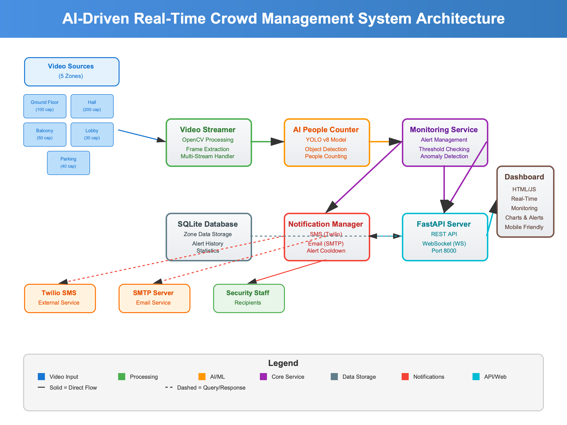
5. Experimental Setup

Slide 14
6. Analysis
Experimental Setup
Input: Live and recorded video streams from multiple zones
Model: YOLOv8 nano for person detection
Evaluation Metrics:
  People count accuracy
  Crowd density percentage
  Alert response time
  System latency

Slide 15
6. Analysis
Results
The system successfully detected and counted people in real time across all monitored zones.
Crowd density levels were accurately classified into Green, Yellow, and Red categories.
Alerts were triggered instantly when thresholds were exceeded, with effective cooldown management.
WebSocket updates ensured near real-time dashboard refresh (every 2 seconds).

Slide 16
6. Analysis
Comparative Performance
Parameter | Traditional Surveillance | Proposed System
Monitoring | Manual | Automated
Real-Time Alerts | No | Yes
Multi-Zone Support | Limited | Full
Accuracy | Low–Moderate | High
Response Time | Delayed | Instant

Slide 17
7. Conclusion
The AI-Driven Real-Time Crowd Management System successfully addresses the challenges of monitoring and managing crowds in public spaces. By leveraging YOLOv8-based computer vision, real-time analytics, and automated alert mechanisms, the system provides an efficient and scalable solution for enhancing public safety. The project achieves accurate people counting, continuous density monitoring, and timely notifications, enabling authorities to respond proactively to potential risks. Future enhancements may include integration with edge devices, advanced anomaly detection models, and deployment on cloud platforms for large-scale smart city applications.

Slide 18
8. References
[1] G. Jocher et al., “YOLOv8: Ultralytics Real-Time Object Detection,” Ultralytics, 2023.
[2] J. Redmon et al., “You Only Look Once: Unified, Real-Time Object Detection,”
Proc. IEEE CVPR, pp. 779–788, 2016.
[3] A. Bochkovskiy et al., “YOLOv4: Optimal Speed and Accuracy of Object Detection,”
arXiv:2004.10934, 2020.
[4] L. Zhang et al., “Crowd Density Estimation Using Deep Learning,”
IEEE Trans. Image Process., vol. 24, no. 11, pp. 1–12, 2015.
[5] M. Li et al., “Video-Based Crowd Analysis Using CNNs,”
IEEE Access, vol. 6, pp. 12345–12356, 2018.

Slide 19
8. References
[6] R. Patel et al., “AI-Based Crowd Monitoring System for Public Safety,”
Proc. IEEE ICACCS, pp. 210–215, 2024.
[7] S. Kumar et al., “Smart Surveillance Using Deep Learning,”
Int. J. Comput. Vision, vol. 32, no. 4, 2022.
[8] X. Chen et al., “Real-Time People Counting Using YOLO,”
IEEE Sensors Journal, vol. 21, no. 9, 2021.
[9] M. Rezaei et al., “DeepSOCIAL: Social Distancing Monitoring,”
arXiv:2008.11672, 2020.
[10] A. Sindagi et al., “A Survey of Crowd Counting Methods,”
IEEE Trans. Circuits Syst. Video Technol., 2018.

Slide 20
Thank You

